Slide 1

Slime Game(Name TBA): Untitled Slime Game
Merritt Hancock, Alan Bettis, Kenda Blair, Ryan Trull

Slide 2
The Game Premise
Players play as a slime and move around on a grid-based board in a turn-based fashion.
If they move over a smaller enemy, the slime will engulf them and the player will absorb mass, growing in the process.
Certain enemies will have abilities that can be absorbed and used by the slime.
Objectives are to absorb all enemies and/or reach an exit.

Slide 3
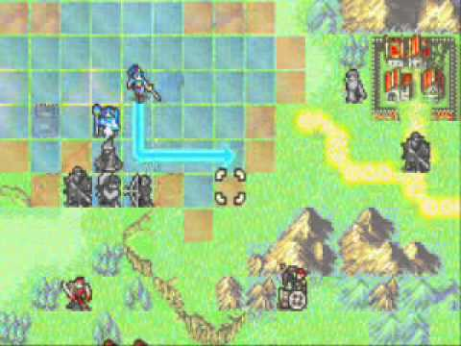
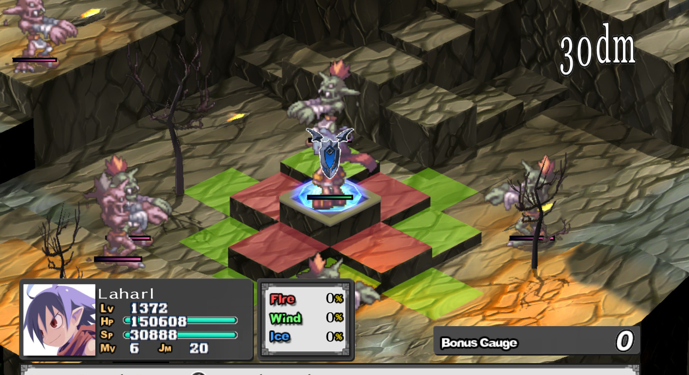
The Game Premise
Inspirations
Disgaea
Fire Emblem

Slide 4
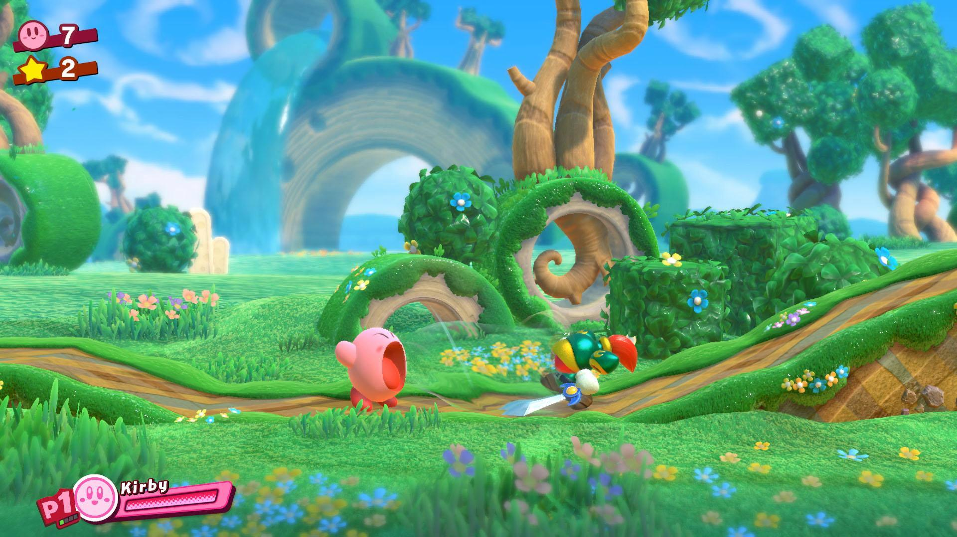
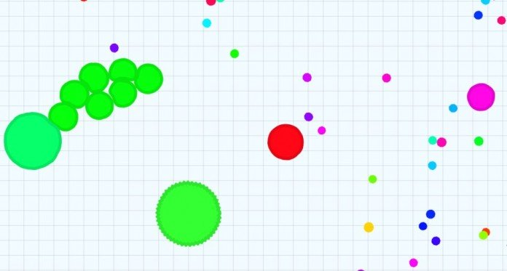
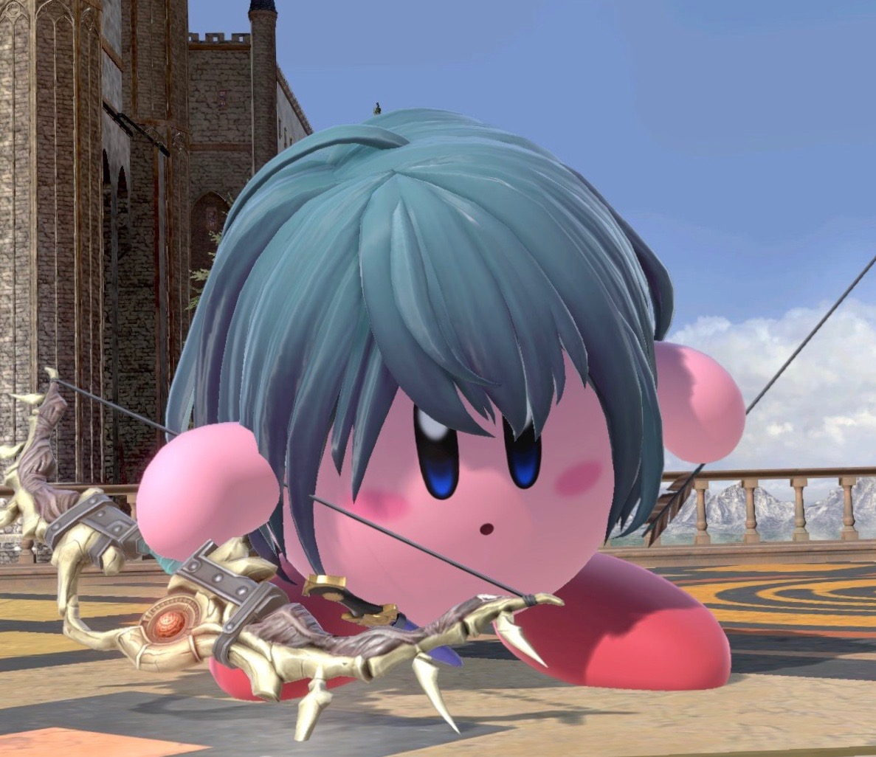
The Game Premise
More Inspirations
Agar.io
Kirby

Slide 5
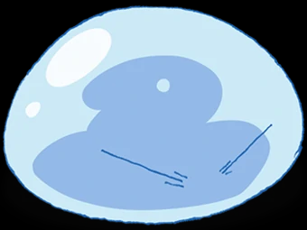
Demo Time!

Slide 6
Camera
Free movement- Uses the arrow keys to call translate axis functions. Left and right arrows translate on x axis. Up and down arrows use the z and y axis simultaneously so that the camera moves parallel to the board.
Zoom- Zoom translates the camera on the z axis using the same translate axis methods used in the free camera movement controls.
Rotation- Rotation is implemented by changing the camera’s position and setting it to face the center of the scene.

Slide 7


Grid Generation
Playing field (or board in our instance) consists of multiple types of terrain tiles.
So far we have four terrain types
Void - empty space which means death if traversed without an ability
Normal - basic space which can be traversed
Rocky - untraversable space
Water - untraversable space
At present, these terrain types all let the player move over them, but we plan to implement untraversable terrain in order to keep the player and enemies contained within the level.

Slide 8
Grid Generation
Grid generation is performed using a 2-Dimensional Array
Each terrain type is given an ID number
Void: -1
Normal: 0
Rocky: 1
Water: 2
The Grid Maker traverses the array, checking each value for an ID, then generates the matching terrain type on a corresponding 1x1 space in the 3-Dimensional game world.
In this instance, the rows and columns are translated the the x and z values in the game.

Slide 9
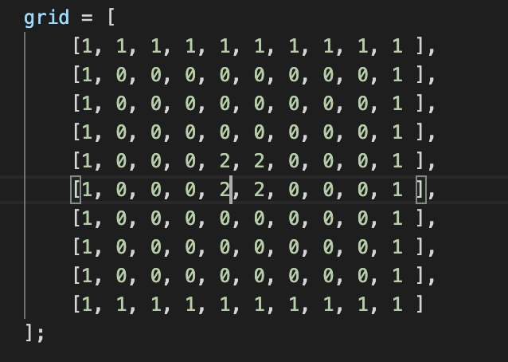
Grid Example
Reference IDs:
Void: -1/ no number
Normal: 0
Rocky: 1
Water: 2

Slide 10
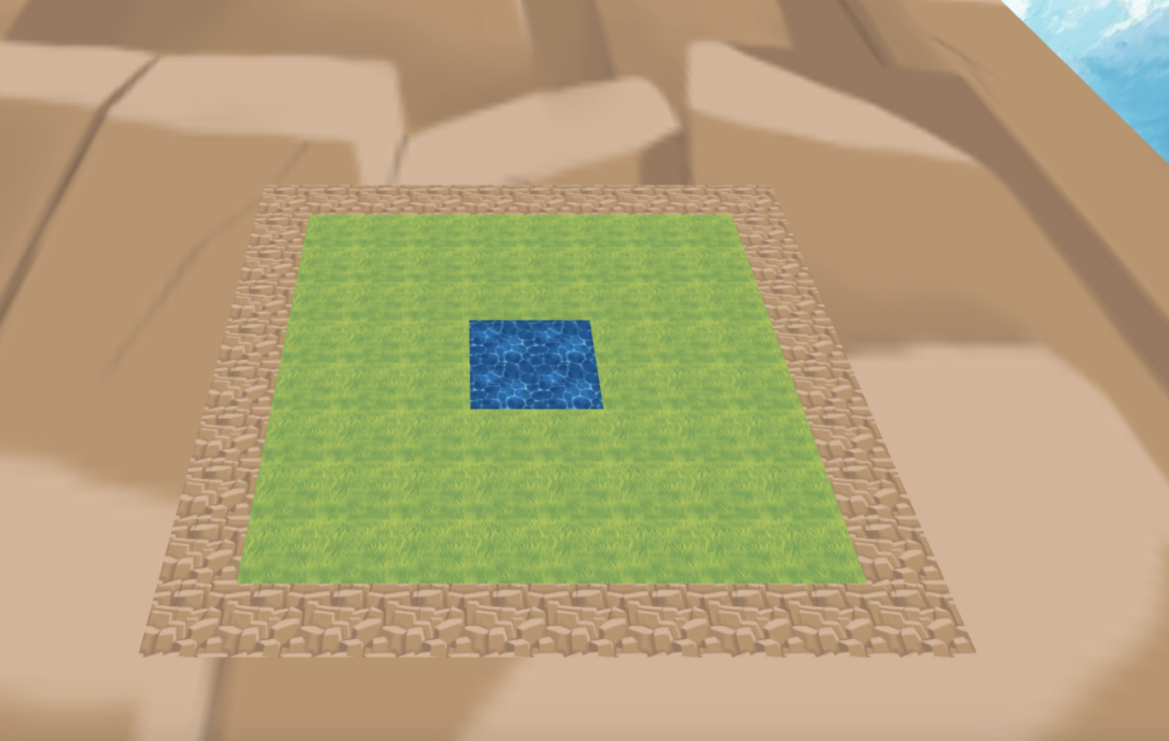
Grid Example

Slide 11

Movement
Movement Restrictions
Unitary - currently
Restricted to grid confines
Untraversable terrain
Ability based movement
Y-axis movement
No fall damage
Cursor
WASD movement
Selection confirmation
Unitary movement - for now

Slide 12
Asynchronous Issues
-Javascript is an asynchronous language, meaning not all the code executes sequentially.
-This can create problems when you want one part of the code to wait until another part has completed execution.
-In this case, the event listener for the keydown event would fire once per frame as long as the key was held.
-How to ensure precise player inputs?

Slide 13

Semaphores
-A system designed to “lock” a part of code so that it must wait until some other code is finished.
-The most basic of semaphores is a boolean variable.
-A piece of code can simply check if the lock is open before executing, and then flip the boolean once it starts.
-In this way, sequence of events can be enforced.

